Slide 1
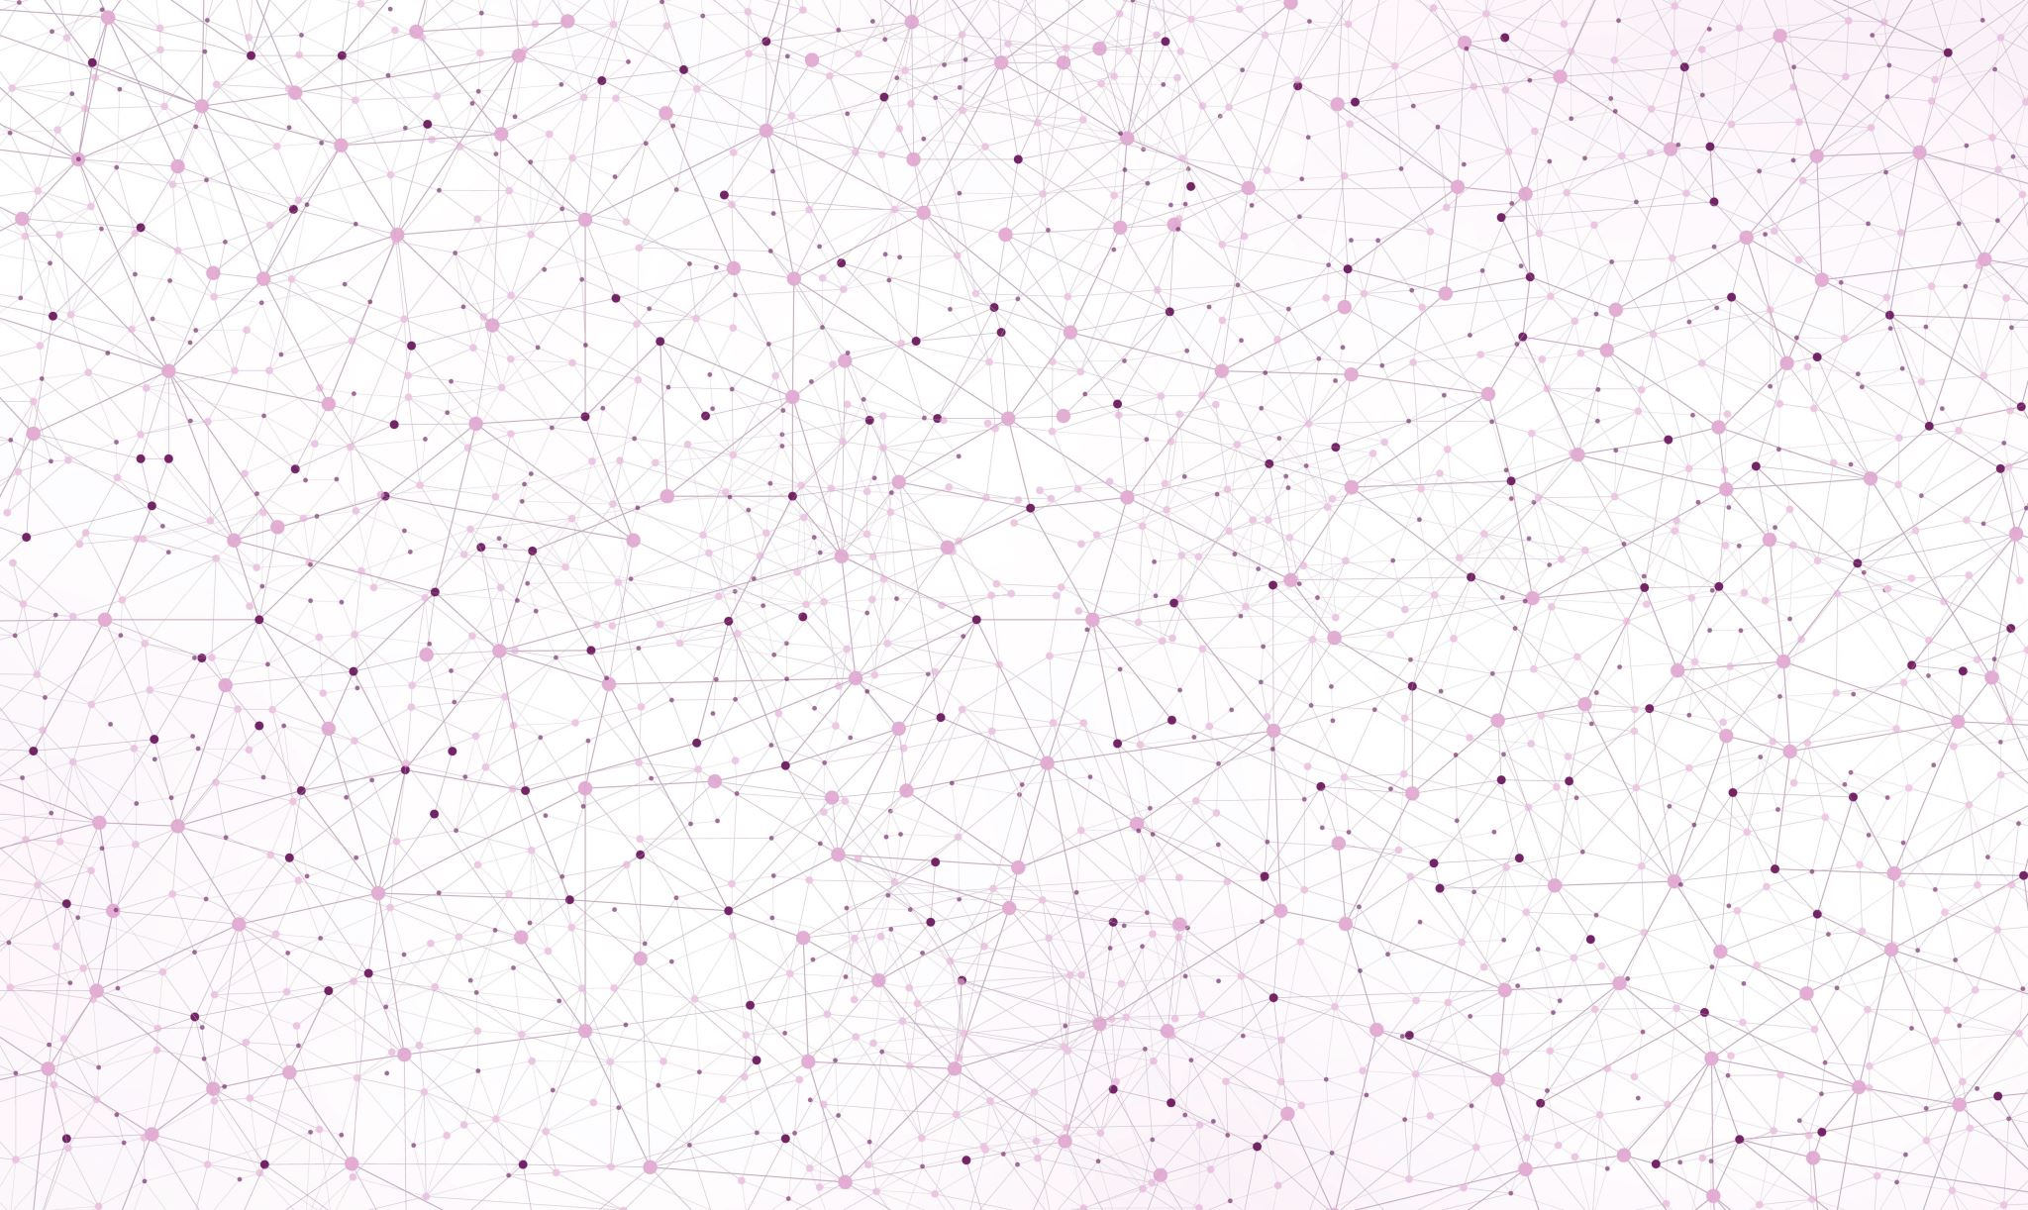
Data augmentation using Stable Diffusion
Haider Ali

Slide 2
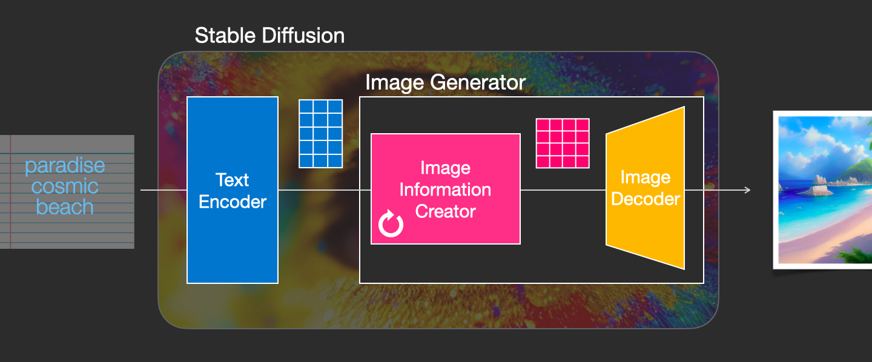
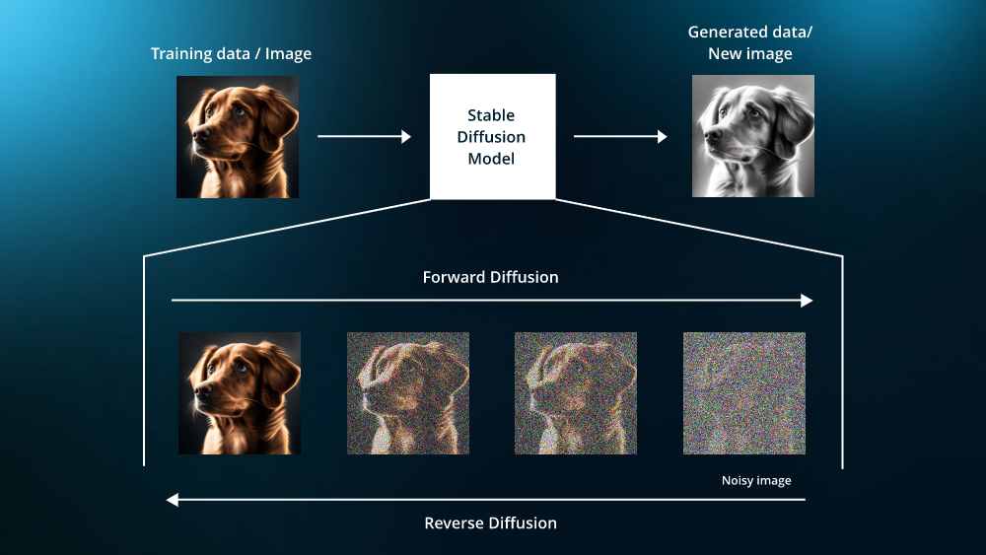
Stable Diffusion model
Image1: Components of a Stable Diffusion model
Credit: https://jalammar.github.io/illustrated-stable-diffusion/
Image 2: Steps of the stable Diffusion model
Credit: https://www.leewayhertz.com/how-to-train-a-diffusion-model/

Slide 3
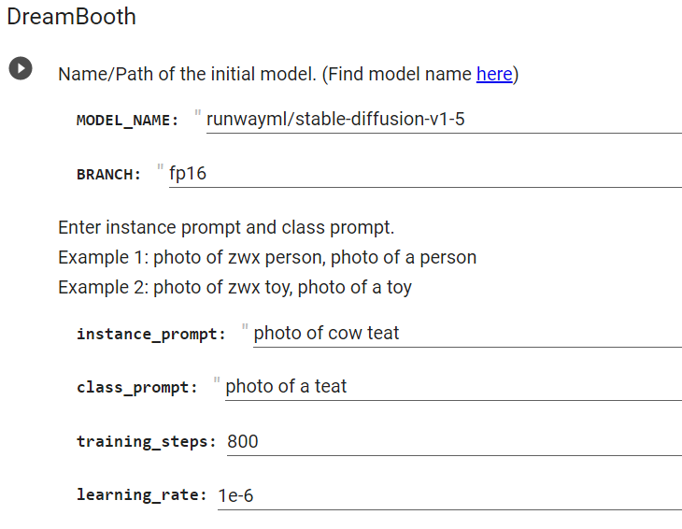
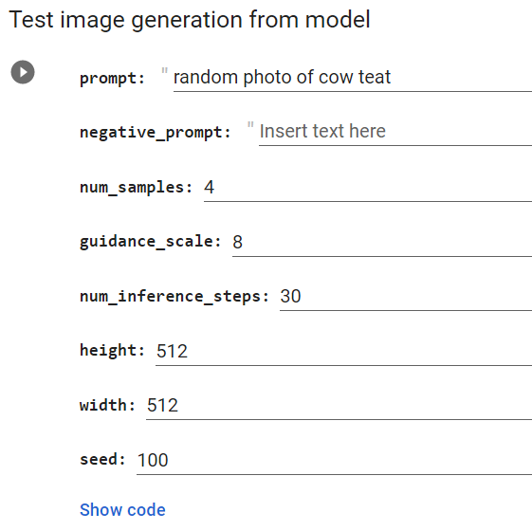
Dreembooth’s Stable Diffusion
Dreembooth model: https://stable-diffusion-art.com/dreambooth/

Slide 4
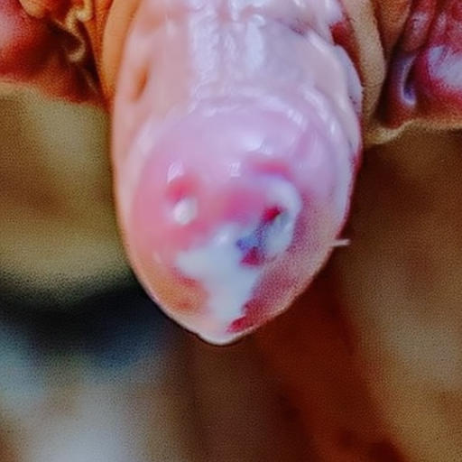
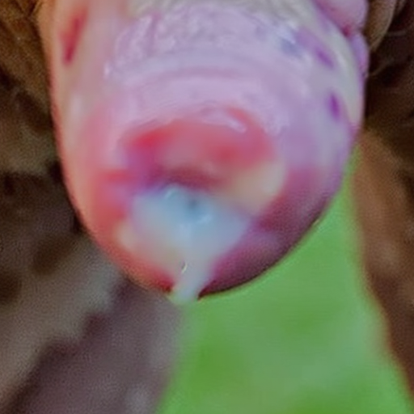
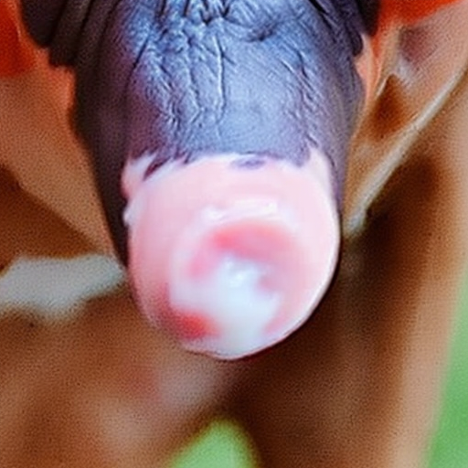
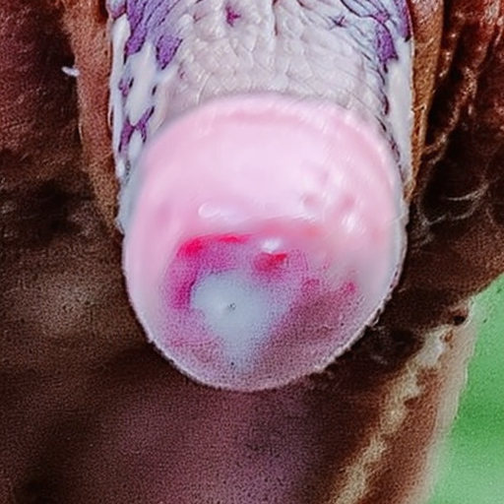
Score 1 (hypokeratosis) generated images

Slide 5
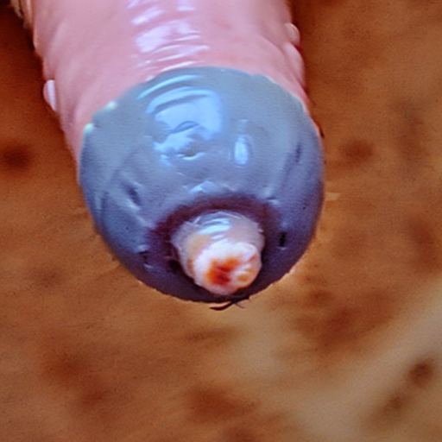
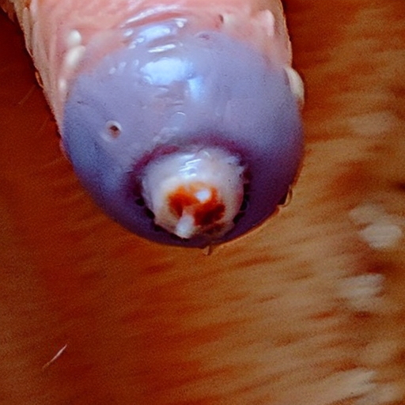
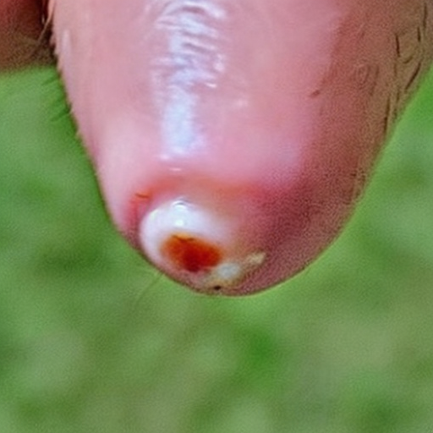
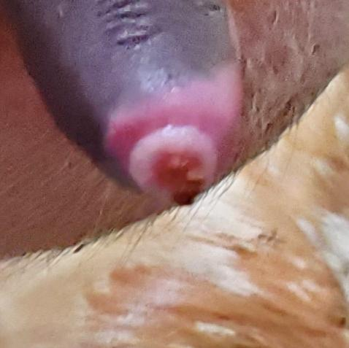
Score 3 generated images

Slide 6
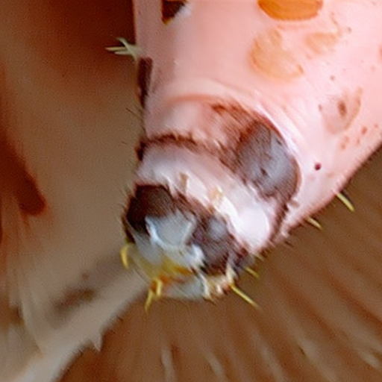
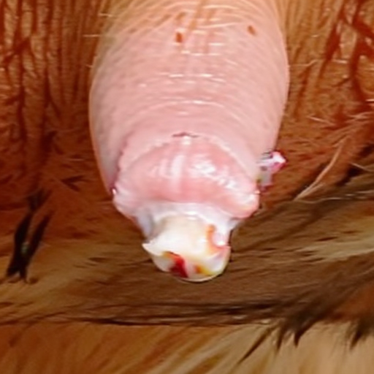
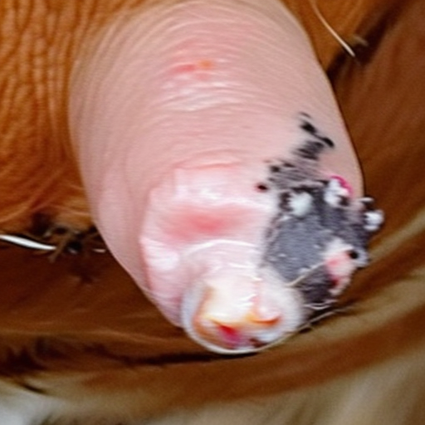
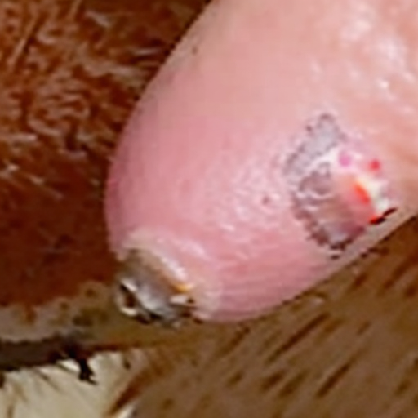
Score 4 (Hyperkeratosis) generated images

Slide 7
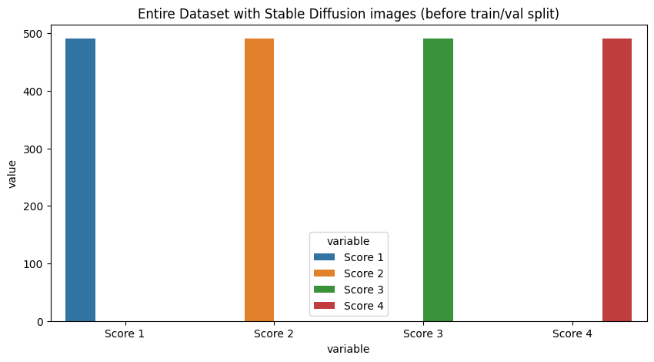
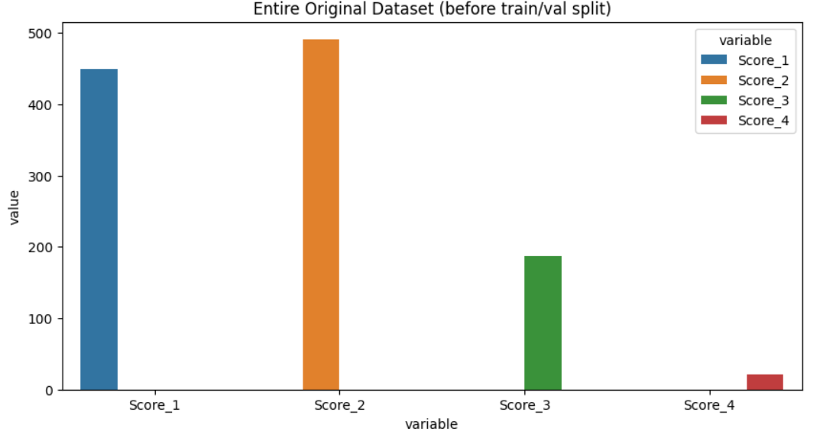
Comparison of images according to classes

Slide 8
Dataset and Hyper-parameters
Loss functions: Used CrossEntropy loss for augmented dataset and Focal loss for original dataset
Learning rate: 0.001, 0.007, 0.005, 0.01.
Used both Adam and SGD.
Augmented dataset split:
Training images: 1571
Validation images: 393
Original dataset split:
Training images: 919
Validation images: 393

Slide 9
Model comparison
Model | Valid Accuracy | Test Accuracy
ResNet 50 | 65.74% | 63.42%
ResNet 50 SD | 81.77% | 63.42%
Custom model | 66.66% | 61.05%
Custom model SD | 83.59% | 61.05%
ResNet 18 | 64.35% | 61.05%
ResNet18 SD | 82.03% | 60.78%
VIT SD | 71.35% | 60.52%
VGG 19 | 49.07% | 59.47%
Inception | 64.35% | 59.47%
VIT | 64.35% | 59.21%
Inception SD | 75.26% | 48.94%
VGG 19 SD | 70.83% | 48.42%

Slide 10

Conclusion and future work
There is not much a difference between the model’s accuracies of original and generated datasets.
It can be concluded that adding extra images or balancing the dataset won’t improve the model’s accuracy.
Advanced techniques can be used such as Separable Confident Transductive Learning to increase achieve better accuracy.

Slide 11

Thanks
Accuracy is not solely dependent on the amount of data, but on the quality, relevance, and understanding of the data at hand.
Questions?

